Slide 1
Introduction

Slide 2
Computer Network
Computer Network is a group of computers connected with each other through wires, optical fibers or optical links so that various devices can interact with each other through a network.
The aim of the computer network is the sharing of resources among various devices.

Slide 3
Networking Elements
At least two computers
Transmission medium either wired or wireless
Protocols or rules that govern the communication
Network software such as Network Operating System

Slide 4
Components of Computer Network
Hub
Repeater
Switch
Router
Cables

Slide 5
Architecture
Peer-To-Peer network
Client/Server network

Slide 6
Network Types
LAN(Local Area Network)
PAN(Personal Area Network)
MAN(Metropolitan Area Network)
WAN(Wide Area Network)

Slide 7
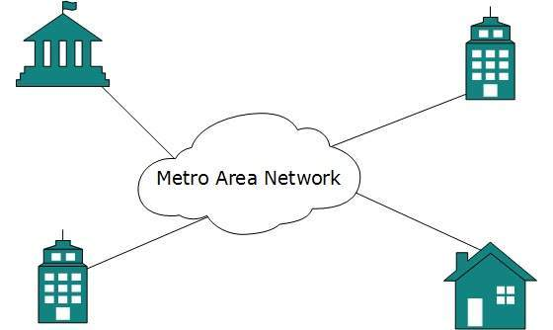
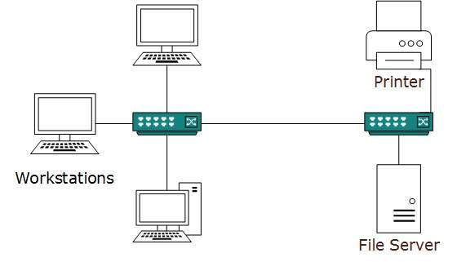
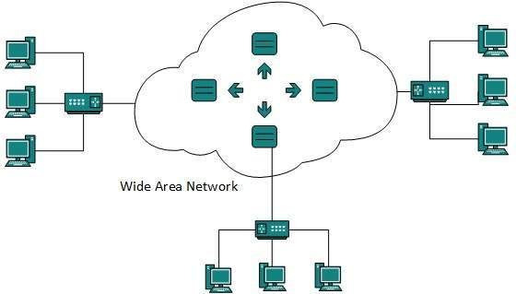

Slide 8
Internetworking
Intranet
Internet

Slide 9
Transmission Mode
The way in which data is transmitted from one device to another device is known as transmission mode.
Simplex mode
Half-duplex mode
Full-duplex mode

Slide 10
Topology
Topology defines the structure of the network of how all the components are interconnected to each other.
Types of Topology
Bus
Ring
Star
Mesh

Slide 11
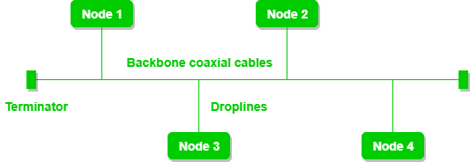
Bus Topology
The bus topology is designed in such a way that all the stations are connected through a single cable known as a backbone cable.
Each node is either connected to the backbone cable by drop cable or directly connected to the backbone cable

Slide 12
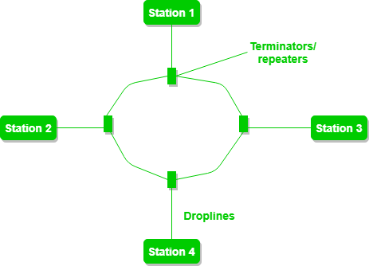
Ring Topology
Ring topology is like a bus topology, but with connected ends.
The node that receives the message from the previous computer will retransmit to the next node.
The data flows in one direction, i.e., it is unidirectional.
It has no terminated ends, i.e., each node is connected to other node and having no termination point.

Slide 13
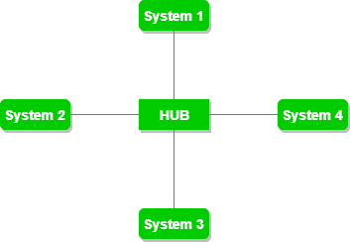
Star Topology
Star topology is an arrangement of the network in which every node is connected to the central hub, switch or a central computer.
The central computer is known as a server, and the peripheral devices attached to the server are known as clients.

Slide 14
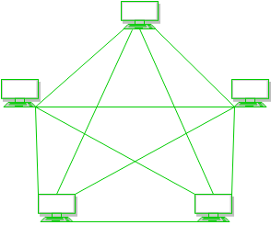
Mesh Topology
In a mesh topology, every device is connected to another device via a particular channel.
There are multiple paths from one computer to another computer.
It does not contain the switch, hub or any central computer which acts as a central point of communication.
The Internet is an example of the mesh topology.

